Slide 1
Figure 1
A
B
Treatment group | No. of mice examined | No. of mice with tumor growth | Tumor Incidence
Control | 6 | 0 | 0%
SFN | 6 | 0 | 0%
UVB (Model) | 26 | 26 | 100%
UVB+SFN | 25 | 20 | 80%
Figure 1.
A, schematic representation of the treatment of sulforaphane (SFN) and exposure in female SKH-1 hairless mice.
B, The effects of UV-irradiation and topical application of SFN. The tumor incidence (%) of each group was calculated from the number of mice without tumor growth over the number of mice examined.

Slide 2
Figure 1
Figure2: Distribution of CpG clusters by cluster size and location within the genome. Majority of the clusters consists of 3 to 7 CpGs and located in the distal intergenic and promoter regions of the genes.

Slide 3
Figure3: Average methylation level by gene region and treatment. Generally, promoters were less methylated (just over 20%) than other parts of the genes (around 50%).

Slide 4
A
B
Figure4: Tumor and normal tissue control, UVB and UVB+SFN sample clustering by (A) Euclidean distance presented as a heatmap with dendrograms and (B) principal component scores presented as a principal component plot of the first two components (PC1 and PC2). There is a notable separation of tumor and normal tissue samples.

Slide 5
A
B
Figure5: Normal tissue control, UVB and UVB+SFN sample clustering by a) Euclidean distance presented as a heatmap with dendrograms and b) principal component scores presented as a principal component plot of the first two components (PC1 and PC2). There is a separation by timepoints (2, 15 and 25 weeks) as well as by control vs. UVB-treated (both, UVB only and UVB+SFN).

Slide 6
A
Figure6: Mean methylation vs. methylation differences in the control group over time: (A) week2 vs. week 15, (B) week 2 vs. week 25, and (C) week 15 vs. week 25. Green and red symbols show differentially methylated regions (DMR) with false discovery rates (FDR) of less than 0.1. The dotted horizontal lines correspond to 20% difference in methylation. Most changes occurred between weeks 2 and 15.
B
C

Slide 7
A
Figure 7: Changes in methylation over time in controls. (A) Heatmap with outermost layer corresponding to Week 15 – Week 2 difference; the middle layer to Week 25 – Week 2, and the innermost layer to Week 25 – Week 15. Only CpG regions with at least 20% difference in methylation and FRD < 0.1 for the first two comparisons are presented. (B) the values corresponding to methylation differences in the heatmap are presented as a table.
B

Slide 8
A
B
Figure8: Mean methylation vs. methylation differences between the treatment groups at week 2. Larger number of differentially methylated regions (DMR) were found between UVB and control (A) compared to UVB and UVB+SFN (B).

Slide 9
A
Figure9: Heatmap (A) and a table with corresponding values (B) show change in methylation at week 2. Venn diagrams (C) show that 17 DMRs were hypermethylated in UVB compared to control and hypomethylated in SFN compared to UVB (FDR < 0.1), while 25 DMRs were hypomethylated in UVB compared to control and hypomethylated in SFN compared to UVB (FDR < 0.1).
B
C
740-16=724
16
54-16=38
3,151-22=3,129
22
51-22=29

Slide 10
A
B
Figure10: Mean methylation vs. methylation differences between the treatment groups at week 15. Larger number of differentially methylated regions (DMR) were found between UVB and control (A) compared to UVB and UVB+SFN (B).

Slide 11
A
Figure11: Heatmap (A) and a table with corresponding values (B) show change in methylation at week 15. Venn diagrams (C) show that 12 DMRs were hypermethylated in UVB compared to control and hypomethylated in SFN compared to UVB (FDR < 0.1), while 7 DMRs were hypomethylated in UVB compared to control and hypomethylated in SFN compared to UVB (FDR < 0.1).
B
Gene | Start | UVB - Control | SFN - UVB
0610040F04Rik | 108570128 | 0.326 | -0.367
Ccdc97 | 25704771 | 0.225 | -0.217
Cdh10 | 18717794 | 0.112 | -0.130
Mageh1 | 153037133 | 0.130 | -0.162
Mturn | 54698998 | 0.270 | -0.247
Mturn | 54699509 | 0.288 | -0.266
Mzt1 | 98959330 | 0.158 | -0.155
Pcdha1 | 36930800 | 0.130 | -0.136
Pfdn5 | 102325379 | 0.383 | -0.378
Soga1 | 157052749 | 0.371 | -0.338
Stat1 | 52171602 | 0.208 | -0.206
Tbx1 | 18586337 | 0.141 | -0.134
1700049E22Rik | 100424971 | -0.048 | 0.064
Cul4b | 38564678 | -0.149 | 0.195
Gse1 | 120437638 | -0.124 | 0.087
Kcnk12 | 87794115 | -0.349 | 0.350
Plcb3 | 6970784 | -0.112 | 0.191
Rtcb | 85967898 | -0.090 | 0.153
Tab3 | 85573831 | -0.194 | 0.294
1,214-12=1,202
12
36-12=24
C
1,425-7=1,418
7
24-7=17

Slide 12
A
B
Figure 12: Mean methylation vs. methylation differences between the treatment groups at week 25. Larger number of differentially methylated regions (DMR) were found between UVB and control (A) compared to UVB and UVB+SFN (B).

Slide 13
A
Figure13: Heatmap (A) and a table with corresponding values (B) show change in methylation at week 25. Venn diagrams (C) show that 16 DMRs were hypermethylated in UVB compared to control and hypomethylated in SFN compared to UVB (FDR < 0.1), while another 16 DMRs were hypomethylated in UVB compared to control and hypomethylated in SFN compared to UVB (FDR < 0.1).
B
Gene | Start | UVB - Control | SFN - UVB
4933407K13Rik | 75723626 | 0.182 | -0.193
Alkbh3 | 94010830 | 0.081 | -0.084
Angpt1 | 42376792 | 0.245 | -0.335
Brca1 | 101519278 | 0.104 | -0.120
Cdc14a | 116436239 | 0.296 | -0.279
Cdc14a | 116461327 | 0.264 | -0.290
Exoc3l4 | 111423310 | 0.123 | -0.124
Gja10 | 32601032 | 0.135 | -0.139
Gm12596 | 59281276 | 0.214 | -0.253
Lpar1 | 58544789 | 0.283 | -0.367
Mn1 | 111419677 | 0.220 | -0.246
Mup5 | 61930624 | 0.145 | -0.198
Pdcd2 | 15536454 | 0.770 | -0.819
Prickle1 | 93521895 | 0.280 | -0.409
Ptpro | 137252656 | 0.105 | -0.101
Ugcg | 59216879 | 0.306 | -0.408
1700029N11Rik | 44455980 | 0.006 | -0.002
1810046K07Rik | 51313019 | -0.071 | 0.081
2410124H12Rik | 92475219 | -0.065 | 0.088
A930005H10Rik | 115848435 | -0.391 | 0.352
Anks1 | 28048473 | -0.263 | 0.240
Bcor | 12081571 | -0.149 | 0.109
Clic5 | 44455980 | -0.247 | 0.192
Gtf2i | 134333082 | -0.107 | 0.117
Lamc2 | 153172234 | -0.078 | 0.086
Loxhd1 | 77366869 | -0.221 | 0.158
Ntrk2 | 58927842 | -0.179 | 0.208
Ric8b | 84918966 | -0.175 | 0.191
Ric8b | 84986110 | -0.219 | 0.253
Scml4 | 42864113 | -0.067 | 0.076
Slc35a3 | 116723548 | -0.186 | 0.307
Spata5l1 | 122629154 | -0.075 | 0.145
Zkscan16 | 58935378 | -0.136 | 0.133
641-16=625
16
97-16=81
C
795-16=779
16
66-16=50

Slide 14
Previous RNA-seq data
Hi Davit, can you compile there to your updated version? Thanks.

Slide 15
Figure 2
A
B
Volume?
number?
**
Remove UA
Remove UA
C - H
Add Histological observation of the control, UVB, UVB+SFN groups
Figure 2. Effects of SFN in UV-induced carcinogenesis
A, Treatment of SFN reduced the tumor volume at 25-week;
B, treatment of SFN reduced the tumor number at 25-week;

Slide 16
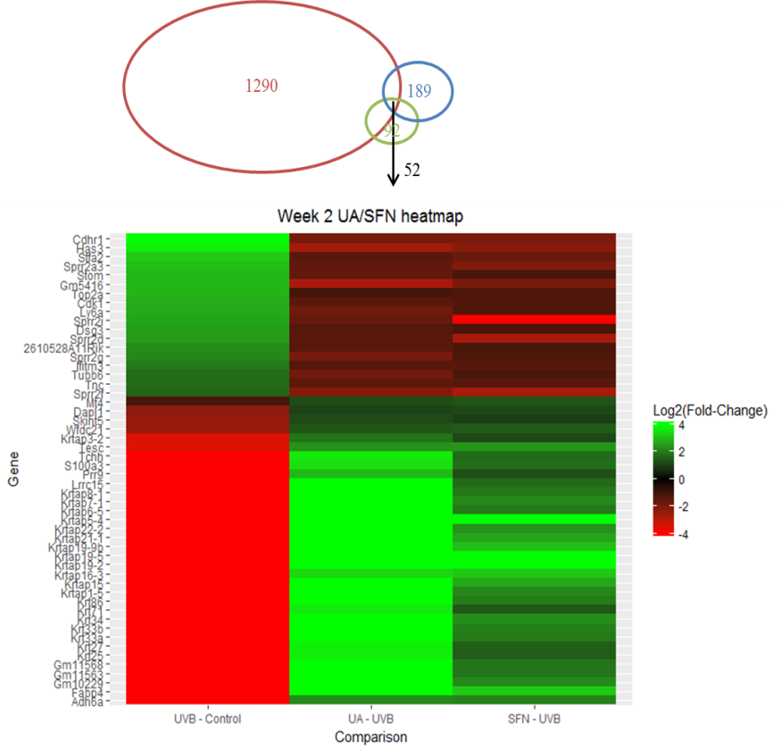
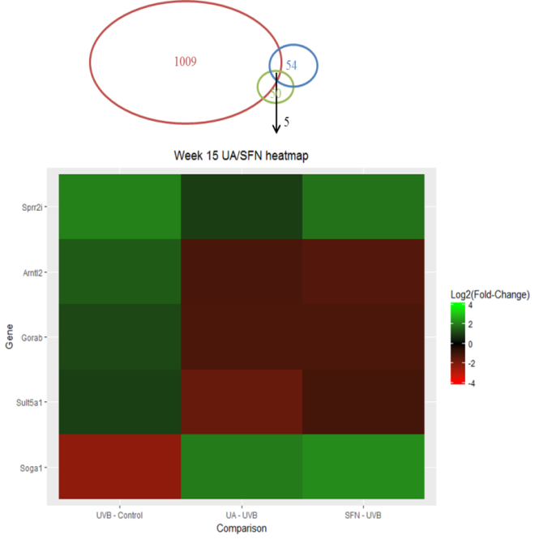
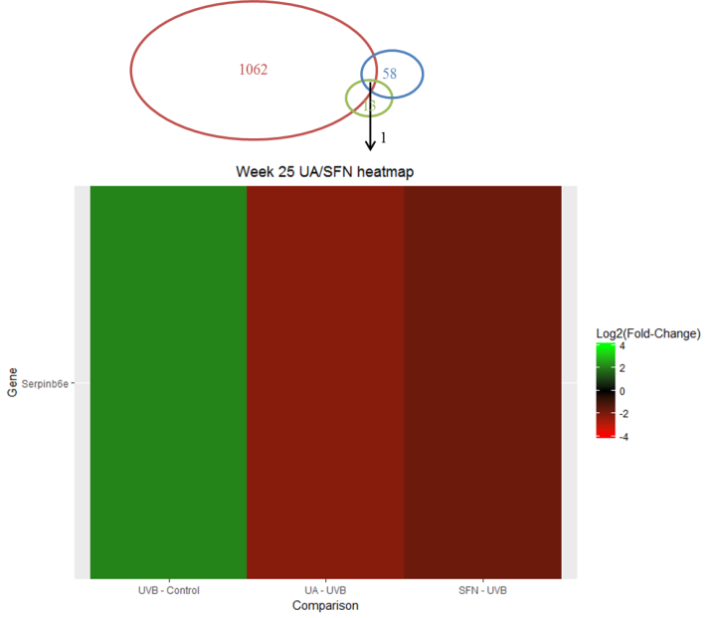
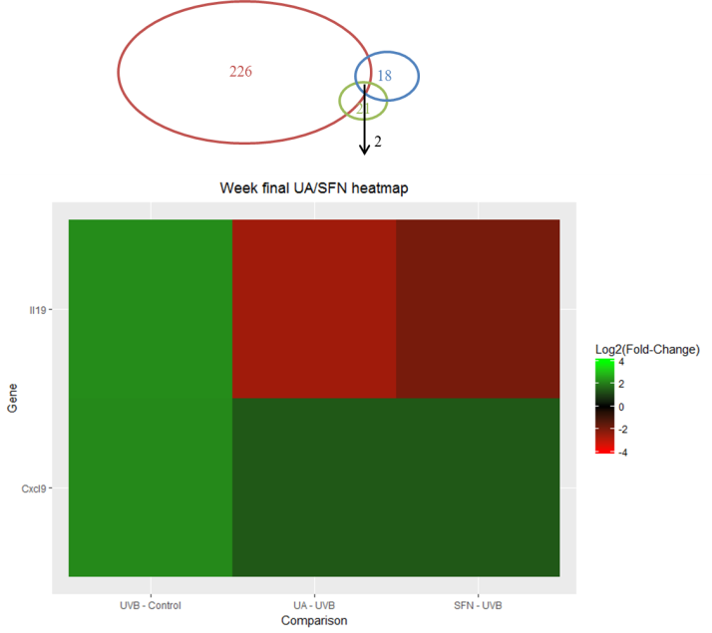
Figure 3
A
B
C
Remove UA
D
Figure 3. Overview of genes regulated by SFN compared to the model group at week 2 (A), week 15 (B) and week 25 (C&D). Green, decreased expression. Red, increased expression.

Slide 17
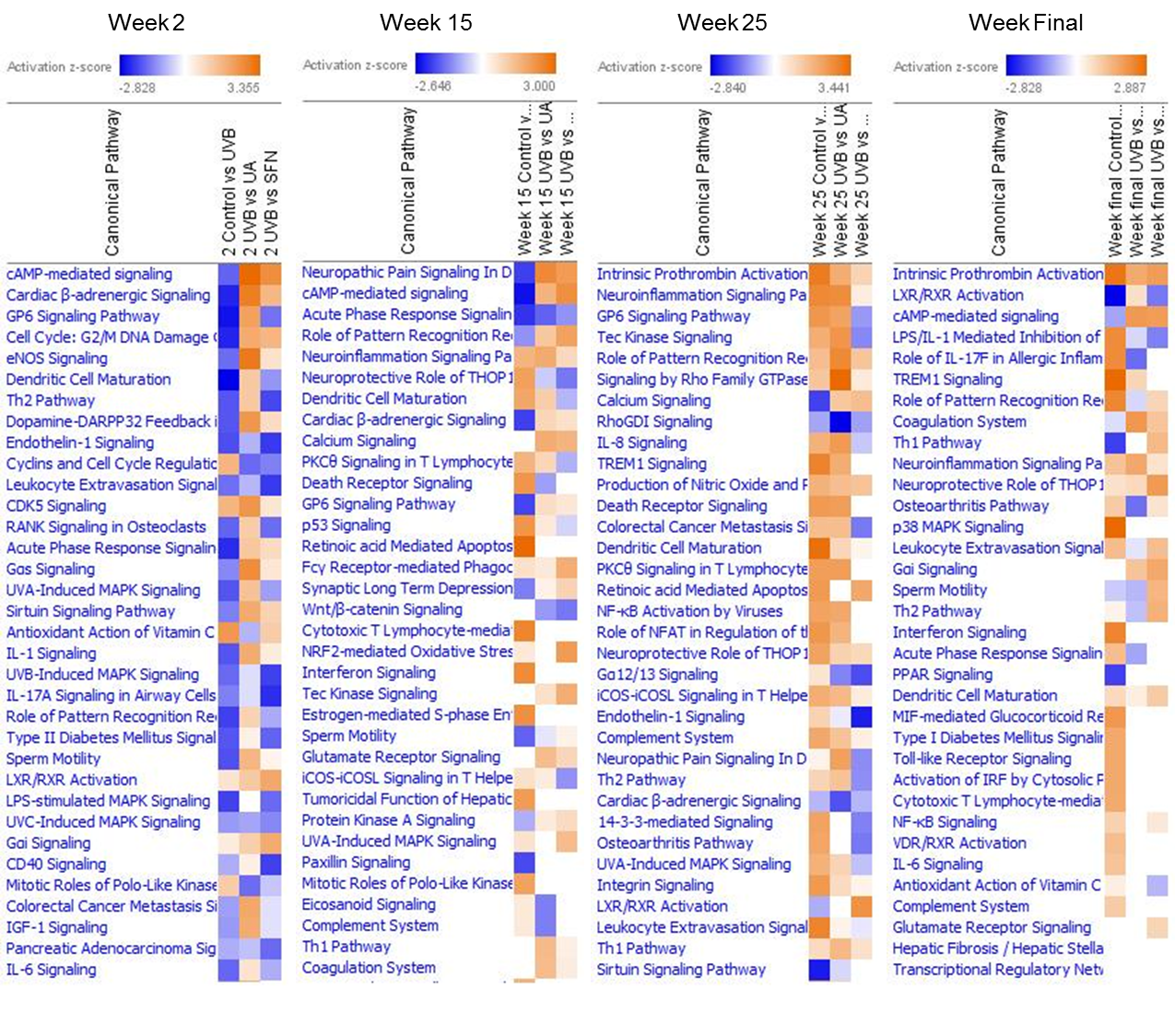
Figure 4
Update labels
Week 25
Tumor
Figure 4. Top canonical pathways of week 2, 15, 25 by Ingenuity Pathway Analysis software in time-point method.

Slide 18
Figure 5
Add qPCR results from validation
Figure 5. Validation of the mRNA expression of selected genes regulated by SFN compared to the model group. mRNA isolated from epidermis (at week-2, -15, and -24) and tumors (at week-24). Black bar: the qPCR results are presented as the fold change compared to the model group, with Gapdh as the housekeeping control. White bar: the fold change compared to the model group from RNA-seq. The data are presented as the mean ± SD (n = 2).

Slide 19
Table 1. Top 10 down-regulated and up-regulated genes in skin epidermis from mice in model group (UVB) compared to the control group (No UVB) . Fold change larger than 1 indicates higher expression in epidermis in model group . Fold change smaller than 1 indicates lower expression in expiermis in Model group.
Ran-IPA
Add Top 10 down & up at week 2 Epidermis
Add Top 10 down & up at week 15 epidermis
Top 10 down & up at week 25 epidermis
Top 10 down & up at week 25 Tumor samples

Slide 20
Table 2. Top 5 canonical pathways of UVB, UA and SFN groups utilized by Ingenuity Pathway Analysis software in group method.
 | Z-score
Top five UVB induced carcinogenesis pathways | week 2 | week 15 | week 25 | week final
Sirtuin Signaling Pathway | -1.41 | -2.50 | -2.56 | -2.12
TREM1 Signaling | 0.38 | 2.24 | 2.84 | 2.89
Interferon Signaling | N/A | 2.33 | 2.53 | 2.33
Cytotoxic T Lymphocyte-mediated Apoptosis of Target Cells | N/A | 2.45 | 2.24 | 1.63
IGF-1 Signaling | -1.13 | -2.24 | 0.63 | -2.00
 | Z-score
Top five UA-UVB pathways | week 2 | week 15 | week 25 | week final
cAMP-mediated signaling | 3.35 | 1.53 | 0.56 | 1.96
Calcium Signaling | 0.78 | 1.67 | 1.29 | 2.53
Dopamine-DARPP32 Feedback in cAMP Signaling | 2.33 | -0.83 | -1.41 | 1.34
eNOS Signaling | 3.00 | 1.51 | 0.45 | 0.63
Gas Signaling | 2.56 | -0.38 | 0.00 | 2.65
 | Z-score
Top five SFN-UVB pathways | week 2 | week 15 | week 25 | week final
cAMP-mediated signaling | 2.53 | 2.24 | 0.43 | 1.89
LXR/RXR Activation | 1.96 | 0.63 | 2.53 | -1.51
Leukocyte Extravasation Signaling | -2.20 | 2.84 | -0.28 | 1.26
Calcium Signaling | 1.81 | 1.51 | 1.50 | 1.13
Gai Signaling | 1.88 | 1.67 | -0.33 | 1.67

